Slide 1
POWER GENERATION
IN HARSH ENVIRONMENTS
Y DUSHYANT

Slide 2
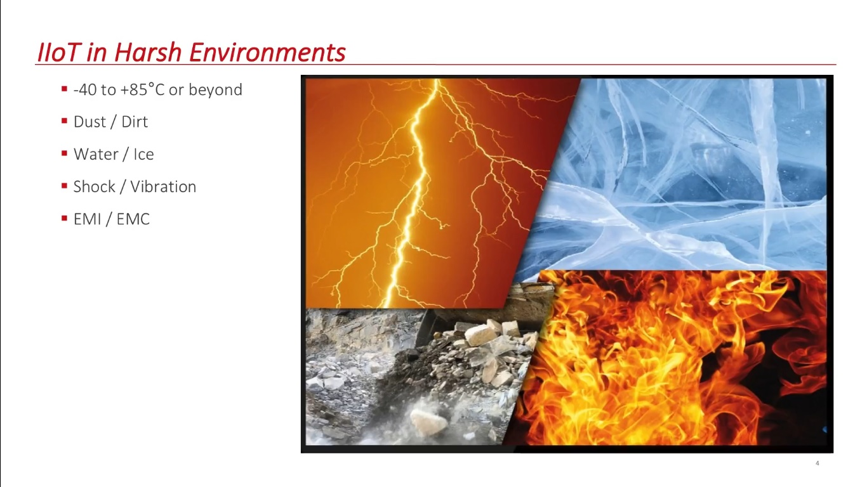

Slide 3
How does IoT help in
Generating power in harsh Environments?

Slide 4
Major Applications :
Digital
Power
plants
Space based SOLAR POWER
COAL
MINES

Slide 5
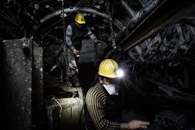
COAL MINES :
Unmanned Vehicles
Predictive Maintenance
Safety
Inventory Management Of Spare Parts
Cloud-Based Logistics

Slide 6
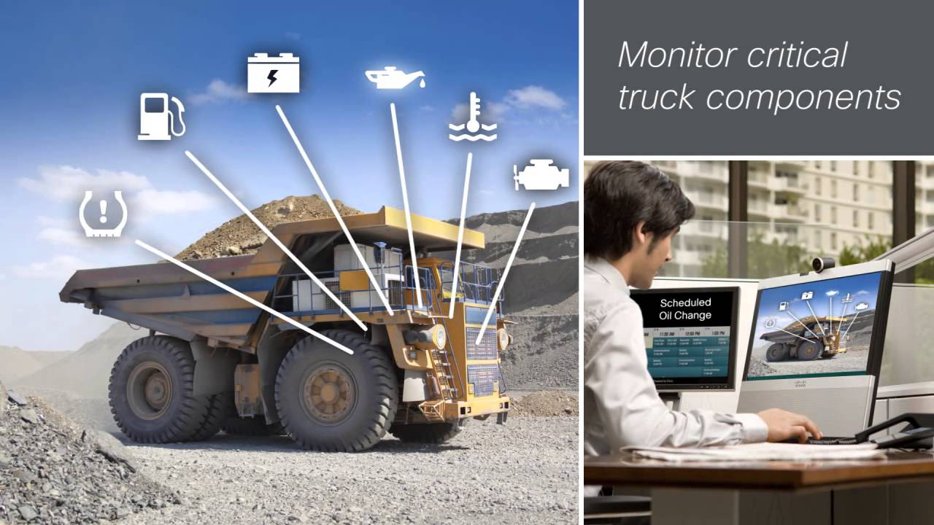
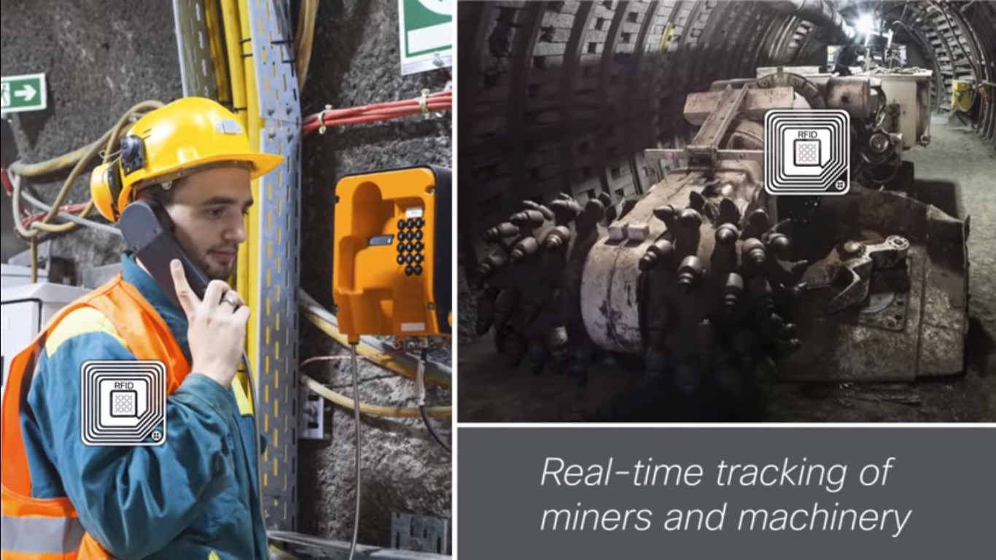

Slide 7
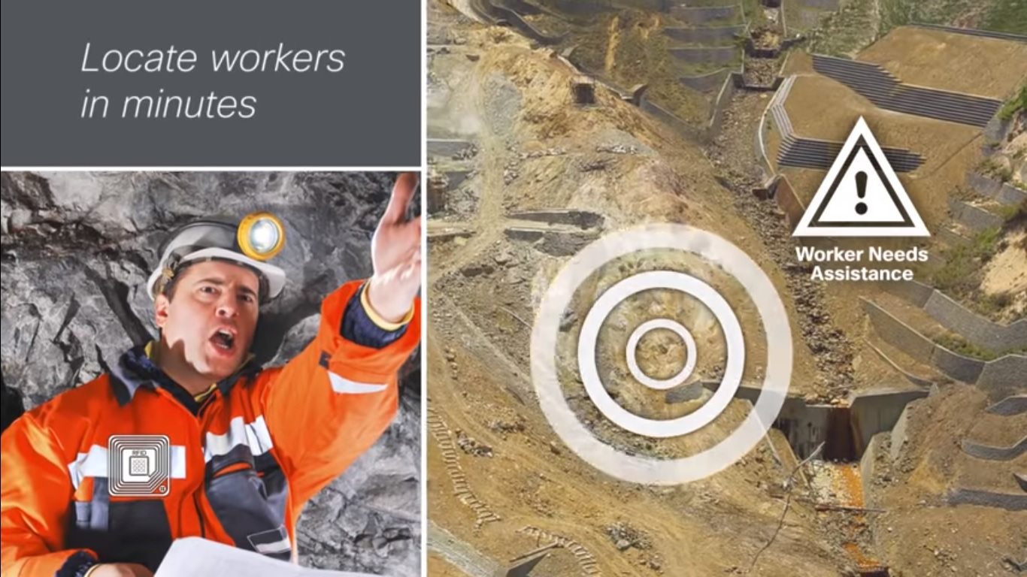
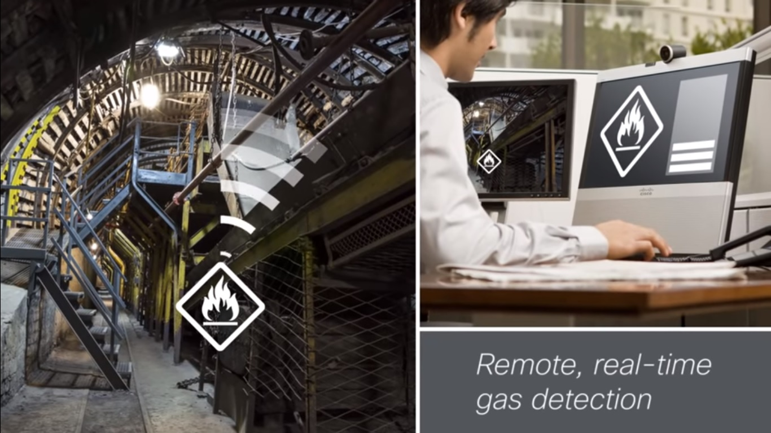

Slide 8
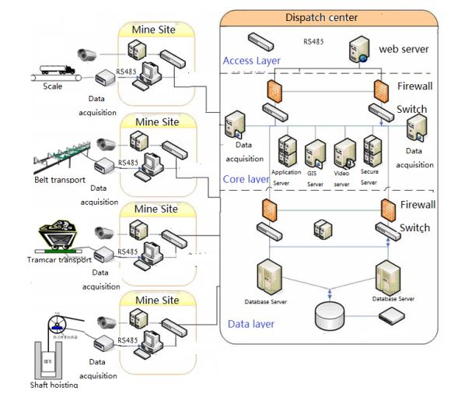

Slide 9
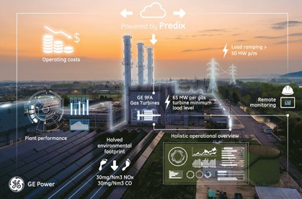
DIGITAL
POWER
PLANTS

Slide 10
Video time!!!

Slide 11
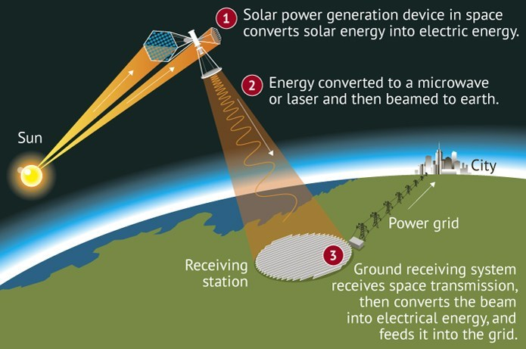
Space
based
Solar
Power

Slide 12
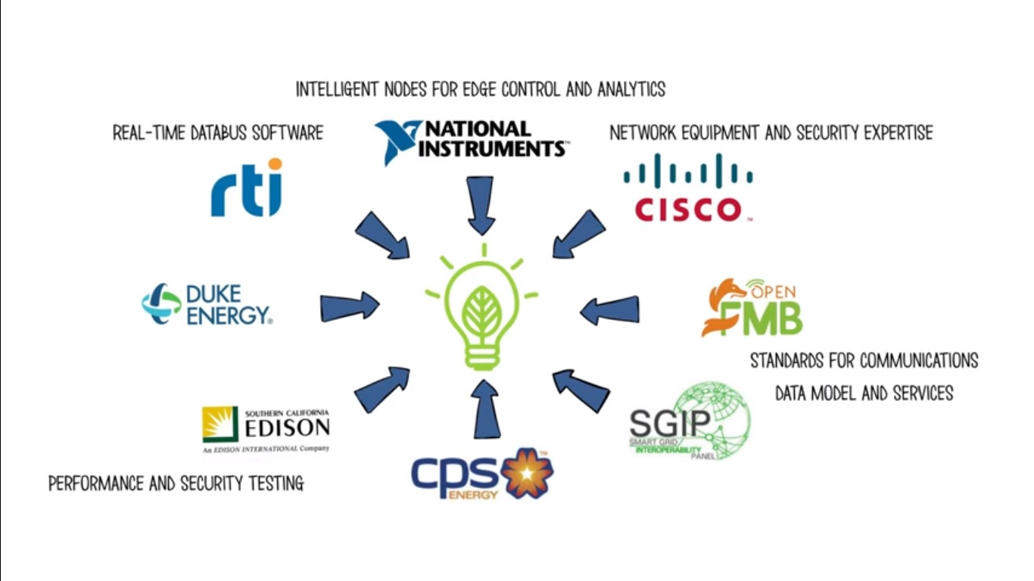

Slide 13
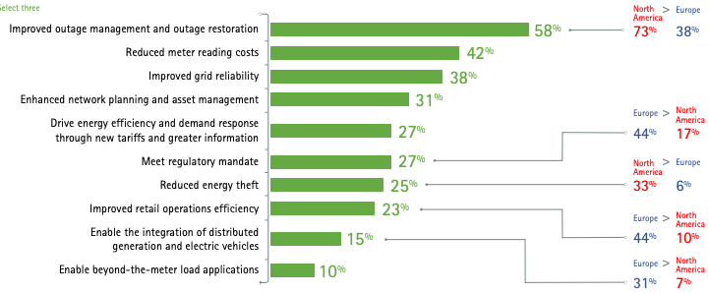

Slide 14
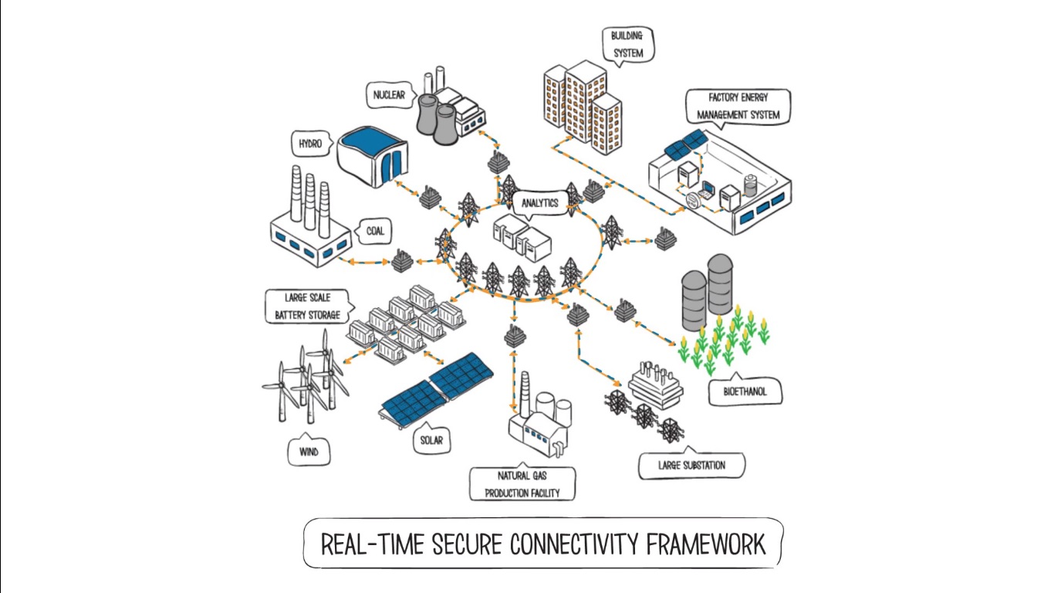
SMART
GRID

Slide 15


